Slide 1



CS 310 : Scalable Software Architectures
Class session on Tuesday, October 15th
Notes:
Focus this week:
Designing and building web services
No class session on Thursday!
Today's session is being recorded…
Project 02 was released
Part 01: web service for photoapp, rewrite client
Part 02: deploy to AWS EC2
Due Friday October 25th

Slide 2
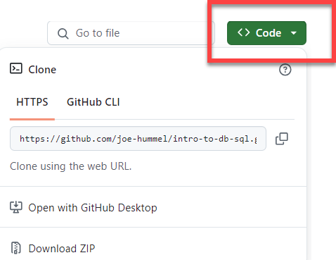
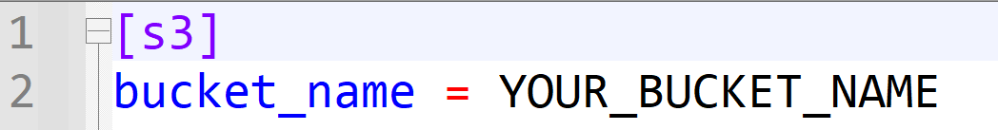
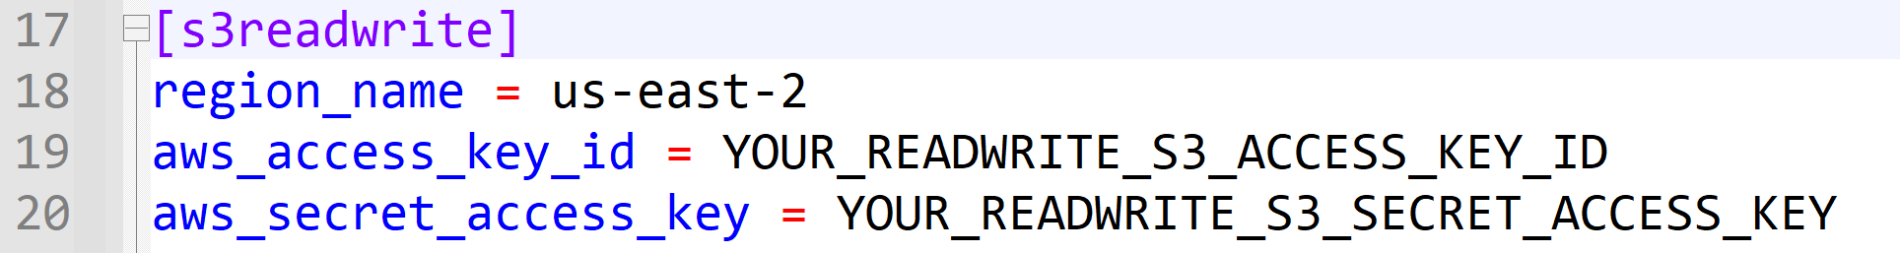
Getting the necessary software
Make sure Docker Desktop is running
Download files you need for today
https://github.com/joe-hummel/web-service-async-demo
Update the repo's .ini file. Two options:
Start your database server, then copy over your photoapp-config.ini file from project 01 to the repo
Open your project 01 photoapp-config.ini file, copy your bucket name and s3readwrite info, and paste into .ini file in the repo

Slide 3
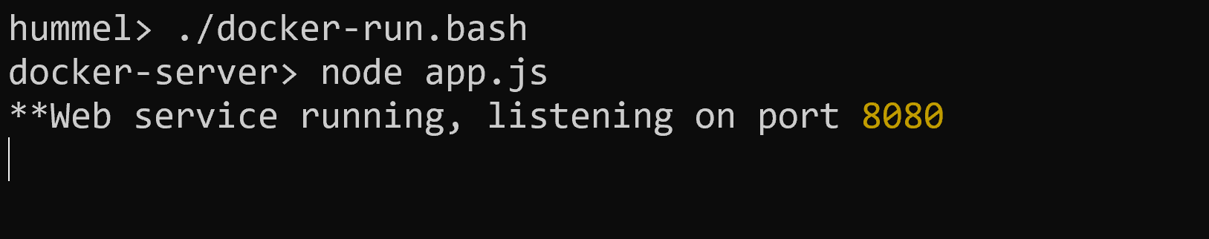
Build and run docker
Open a terminal window, navigate to repo:
Linux/Mac/Windows WSL:
Open terminal, navigate to repo folder
chmod 755 *.bash
./docker-build.bash
./docker-run.bash
Windows:
Open Powershell, navigate to repo folder
.\docker-build.bat
.\docker-run.bat

Slide 4
Common docker errors
"docker" command not found
Uninstall and reinstall Docker Desktop
When you try to build, you are not authorized
docker login -u docker-username
When you try to run, you get errors like "bash: $\r: command not found"
If you see the docker> prompt, type exit
((Get-Content .bashrc) -join "`n") + "`n" | Set-Content -NoNewLine .bashrc

Slide 5
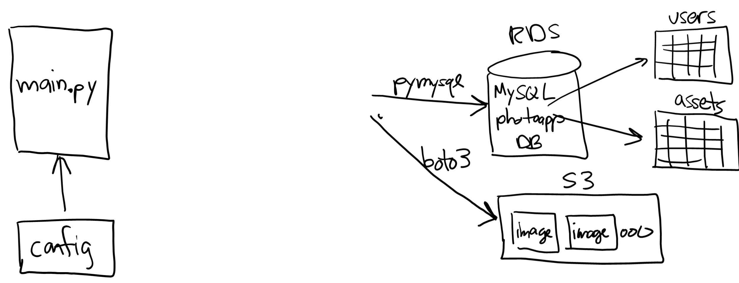
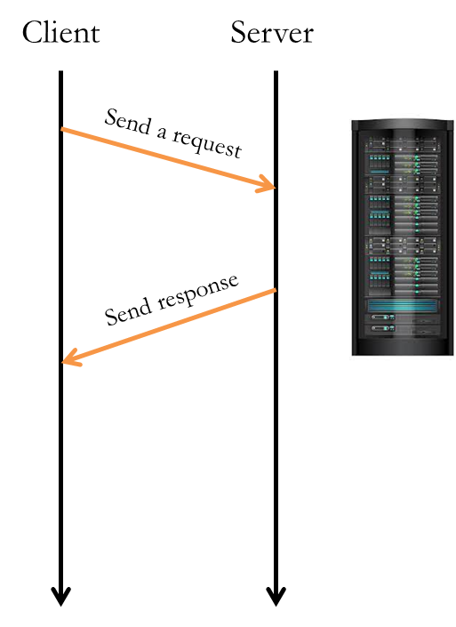






Project 02

Slide 6
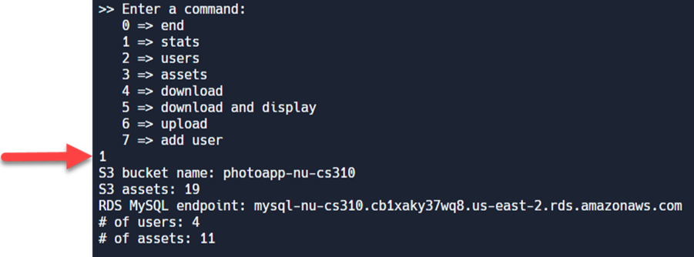
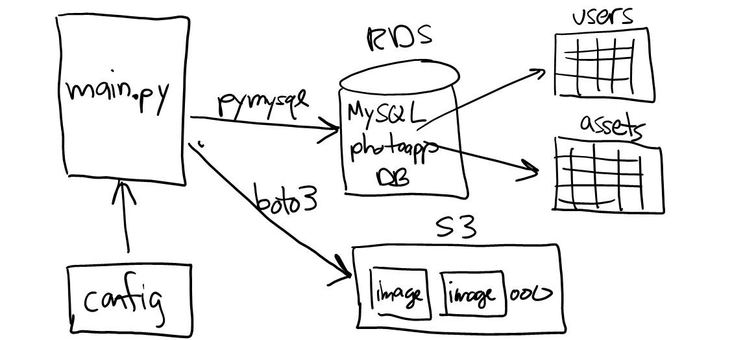
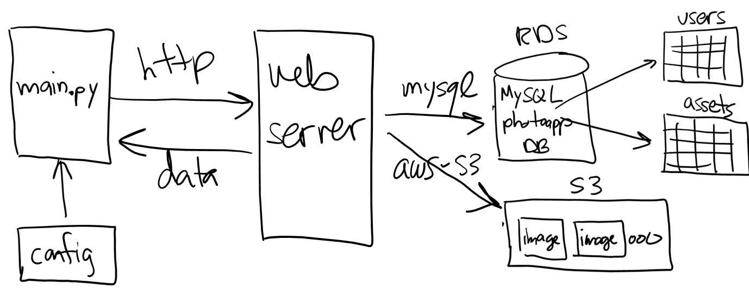
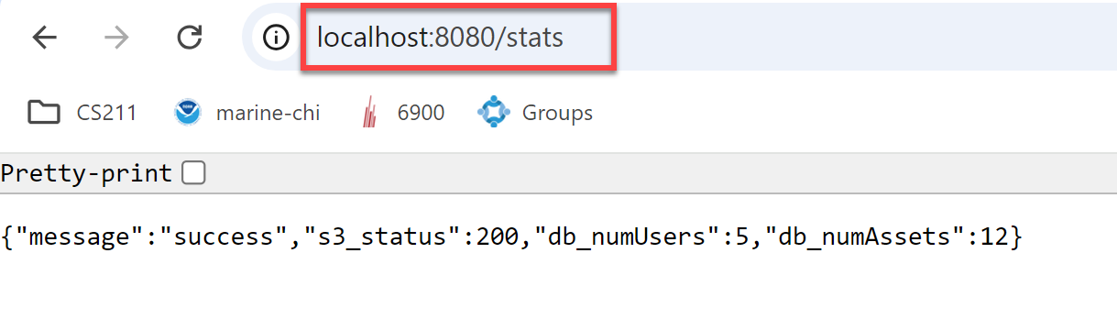
Accessing S3
Recall the "stats" command from project 01…
Project 02 has a similar command…
app.get('/stats', (req, res) => {
(1) call S3, get status of bucket
(2) call MySQL, get # of users in the users table
(3) call MySQL, get # of assets in the assets table
(4) res.json({ "message": ...,
"s3_status": ...,
"db_numUsers": ...,
"db_numAssets": ... });
});

Slide 7
Attempt #1
app.get('/stats', (req, res) => {
console.log("**Call to get /stats...");
let input = {
Bucket: s3_bucket_name
};
let command = new HeadBucketCommand(input);
let s3_response = photoapp_s3.send(command);
res.json({ "message": "success",
"s3_status": s3_response["$metadata"]["httpStatusCode"],
"db_numUsers": -1,
"db_numAssets": -1 });
});
S3 call is asynchronous, you have to wait for response…

Slide 8
Promises
The modern way to wait…
A promise is an object that eventually resolves to a value
When you need the value, you "await" for it
Example: s3.send(…)
app.get('/path', async (req, res) => {
try {
let response = F(params); // F returns a promise
let result = await response;
res.json(result);
}
catch(err) { res.status(500).json(…); }
});

Slide 9
Solution
app.get('/stats', async (req, res) => {
console.log("**Call to get /stats...");
let input = {
Bucket: s3_bucket_name
};
let command = new HeadBucketCommand(input);
let s3_response = photoapp_s3.send(command);
let s3_result = await s3_response;
res.json({ "message": "success",
"s3_status": s3_result["$metadata"]["httpStatusCode"],
"db_numUsers": -1,
"db_numAssets": -1 });
});

Slide 10
Accessing MySQL
The /stats function is also supposed to get the # of users and # of assets in the database…
app.get('/stats', (req, res) => {
call S3, get status code of bucket
call MySQL to get # of users in the users table
call MySQL to get # of assets in the assets table
res.json({ "message": ...,
"s3_status": ...,
"db_numUsers": ...,
"db_numAssets": ... });
});

Slide 11
Callbacks
MySQL library is based on callbacks, not promises…
In this case, the result is ONLY available inside the callback
Example: db.query(…)
app.get('/path', (req, res) => {
try {
db.query(sql, (err, result, …) => {
try {
if (err)
res.status(500).json(err.message);
else
res.json(result);
}
catch(err) {…}
});
}
catch(err) {…}
});

Slide 12
Solution
app.get('/stats', async (req, res) => {
console.log("**Call to get /stats...");
let input = {
Bucket: s3_bucket_name
};
let command = new HeadBucketCommand(input);
let s3_response = photoapp_s3.send(command);
let sql = "select count(*) as NumUsers from users;";
photoapp_db.query(sql, async (err, db_result, _) => {
if (err) {
res.status(500).json({ … });
}
else {
let row = db_result[0]; // we got one row back, extract it
let s3_result = await s3_response;
res.json({ "message": "success",
"s3_status": s3_result["$metadata"]["httpStatusCode"],
"db_numUsers": row["NumUsers"],
"db_numAssets": -1 });
}//else
});
});
We await for S3 inside the callback so it runs concurrently with MySQL…
We have to move the res.json( ) into the callback as well because this is where the results are

Slide 13

What about the # of assets?
We also have to count the # of assets in the assets table…
This implies nesting ANOTHER callback and moving res.json( )…
app.get('/stats', async (req, res) => {
.
.
.
let sql = "select count(*) as NumUsers from users;";
photoapp_db.query(sql, async (err, db_result, _) => {
if (err) {
res.status(500).json({ … });
}
else {
let user_row = db_result[0];
let sql = "select count(*) as NumAssets from assets;";
photoapp_db.query(sql, async (err, db_result, _) => {
if (err) {
res.status(500).json({ … });
}
else {
let asset_row = db_result[0];
let s3_result = await s3_response;
res.json({ "message": "success",
"s3_status": s3_result["$metadata"]["httpStatusCode"],
"db_numUsers": user_row["NumUsers"],
"db_numAssets": asset_row["NumAssets"] });
}
});
}
});
});

Slide 14


Slide 15
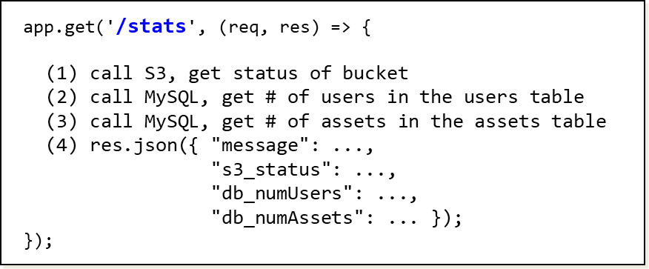
Goal

Slide 16
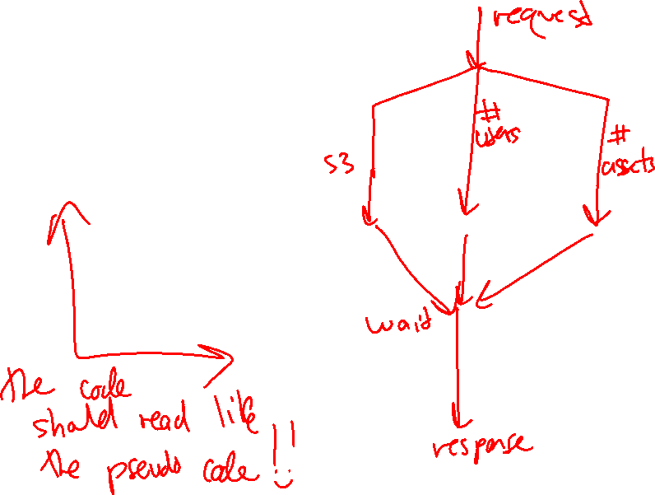
Goal

Slide 17
Step #1
Turn the callback into a promise, then await!
let db_result = new Promise( (resolve, reject) => {
let sql = "select count(*) as NumUsers from users;";
photoapp_db.query(sql, (err, rows, …) => {
try {
if (err)
reject(err);
else
resolve(rows[0]); // we want the first row
}
catch(err) { reject(err); }
});
});
let user_row = await db_result;

Slide 18
Step #2
Turn both callbacks into promises…
Get it to work synchronously with await

Slide 19
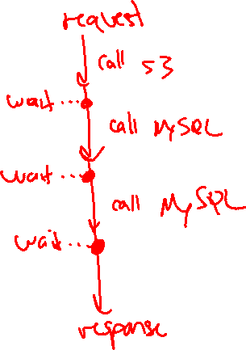
Step #2
Turn both callbacks into promises…
Get it to work synchronously with await

Slide 20
Step #3
Now let's maximize concurrency with Promise.all
let results = await Promise.all([s3_result, db_result, db_result2]);
s3_result = results[0]; // first result
users_row = results[1]; // second result
assets_row = results[2]; // third result
res.json({ ... });

Slide 21
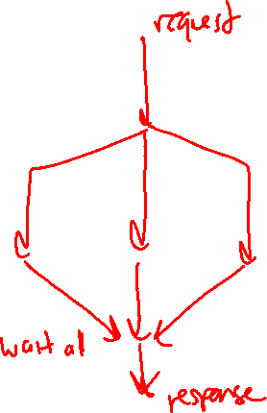
Step #3
Now let's maximize concurrency with Promise.all
let results = await Promise.all([s3_result, db_result, db_result2]);
s3_result = results[0]; // first result
users_row = results[1]; // second result
assets_row = results[2]; // third result
res.json({ ... });

Slide 22
That's it, thank you!

Slide 23
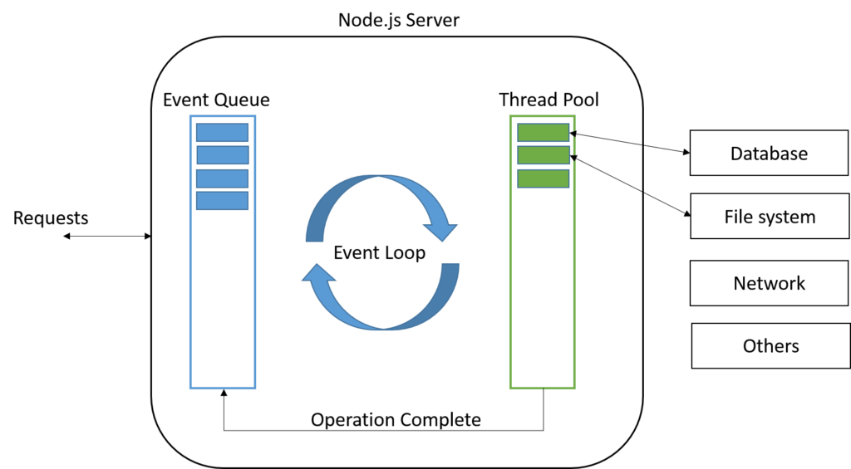


Node.js
Single-threaded with large software library (MySQL, S3, …)
https://nodejs.org/api/documentation.html
Notes:
Look at File System in the documentation --- e.g. read functions return promises! Because FS could be on a separate machine…

